Slide 1
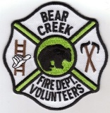
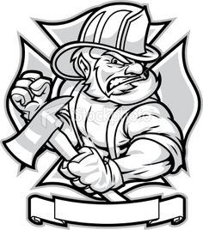
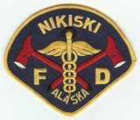
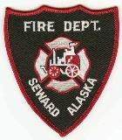
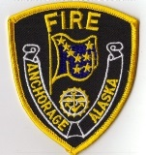
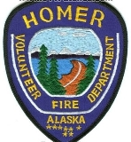
Cook Inlet MFF Workgroup
Report to the CIHSC

Slide 2
What is the function of a MFF Workgroup?
The Mission Statement of the MFF workgroup defines the Scope of Work to achieve.
Safety of firefighters responding to a Marine Incident.
Safety of life and property for Industry and the Public
To use Subject Matter Expertise and teamwork to set a standard for exemplary response utilizing all available means and best practices.
Striving for Continuous Improvement
Notes:
A good place to start for this report is to explain what the function and SOW the workgroup envisions. What is our function and what are our goals? Read the list. The HSC is defined by the USCG as a local port coordinating body (not authority), whose responsibilities include recommending actions to improve the safety and efficiency of a port or waterway. The Marine FF workgroup fulfills this objective through multiple avenues.

Slide 3
Notes:
The MFF workgroup must be fit for purpose for Cook Inlet. It is and should be a continious drive to meet a particular response capability deemed appropriate. The MFF workgroup is not a standing committee per the HSC charter, but it is a long term project to achieve the level of protection and mitigation expected by industry.. While most workgroups strive to be small in an effort to get things done, the very nature of MFF requires the entire buy-in of response organizations and FDs, coordinating with the USCG. Meaning all the Fire services that would or could be expected to respond to a marine fire. Our group is still growing. It is not a social club or a place to tell old stories of fires of days gone by. It is a place to get things accomplished that meet the objective of the workgroup. Well, maybe some stories.

Slide 4
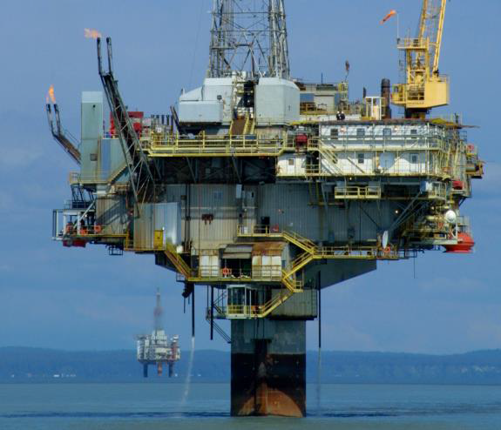
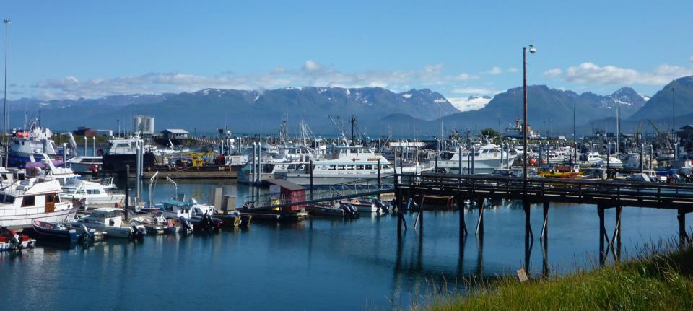
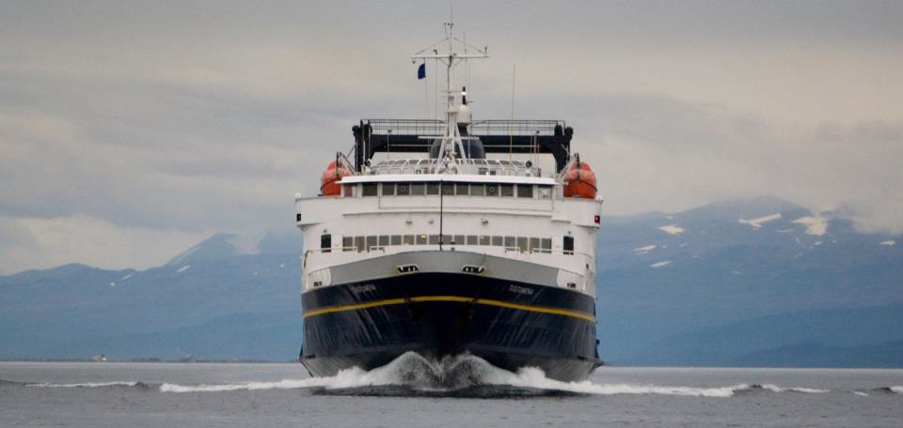
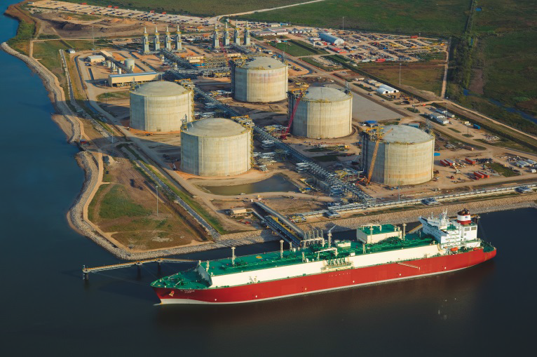
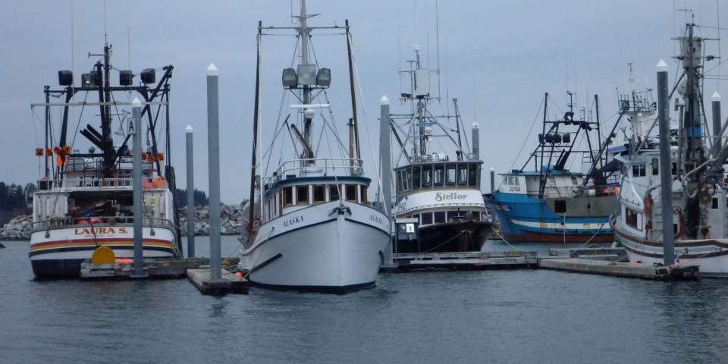
Notes:
What are we talking about with the term Marine Firefighting? Lets go down the list.
Platforms and Rigs-CHECK, Marinas-CHECK, LNGC’s-CHECK, Tank farms adjacent to terminals-CHECK, Fishing vessels-CHECK, NEXT SLIDE

Slide 5
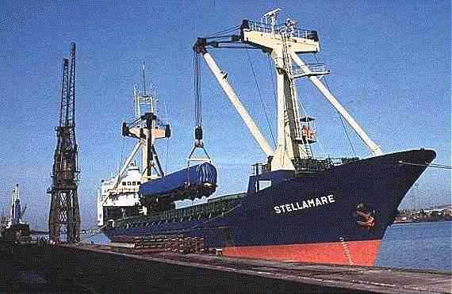
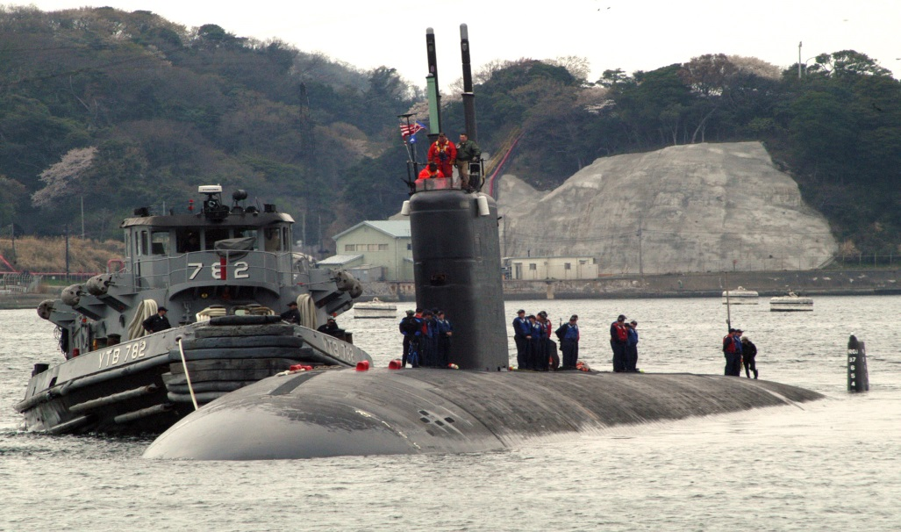
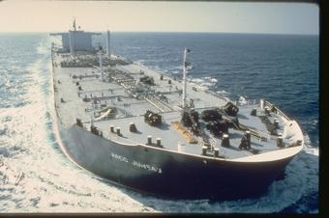
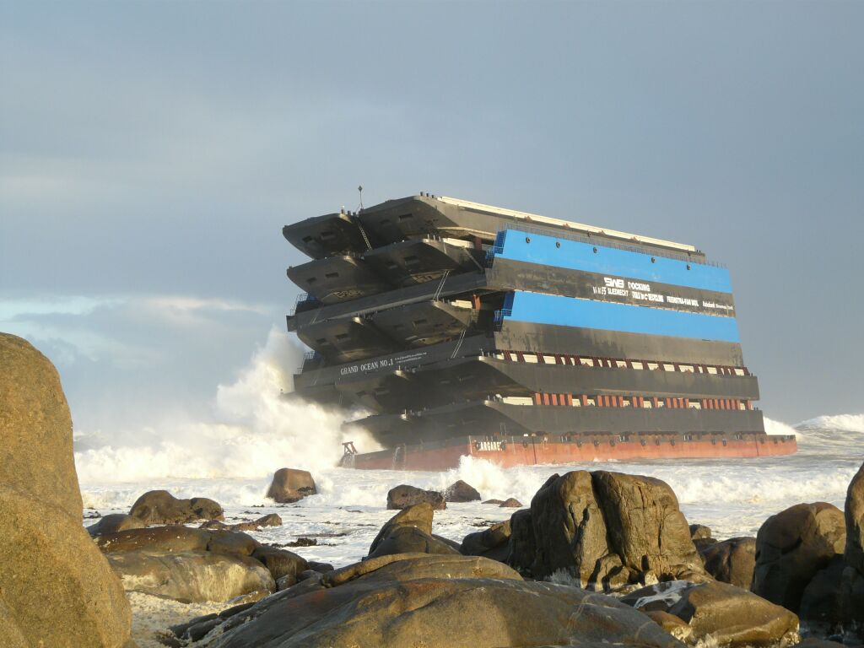
Notes:
Heavy Lift-CHECK, Military vessels-CHECK, Tank Vessels, CHECK, Barges, CHECK,

Slide 6
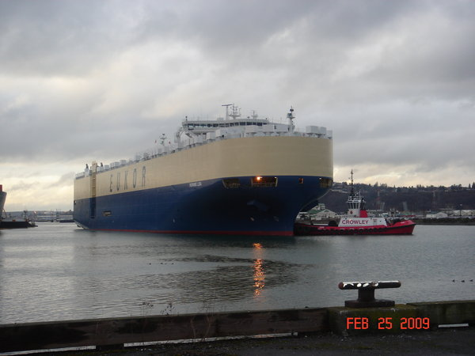
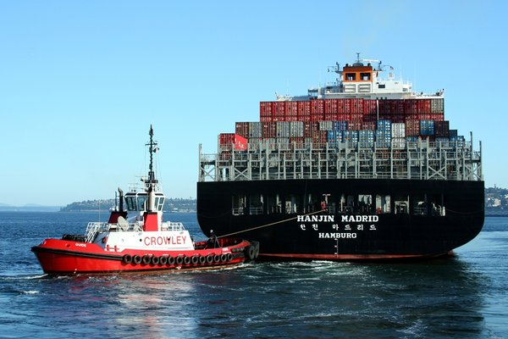
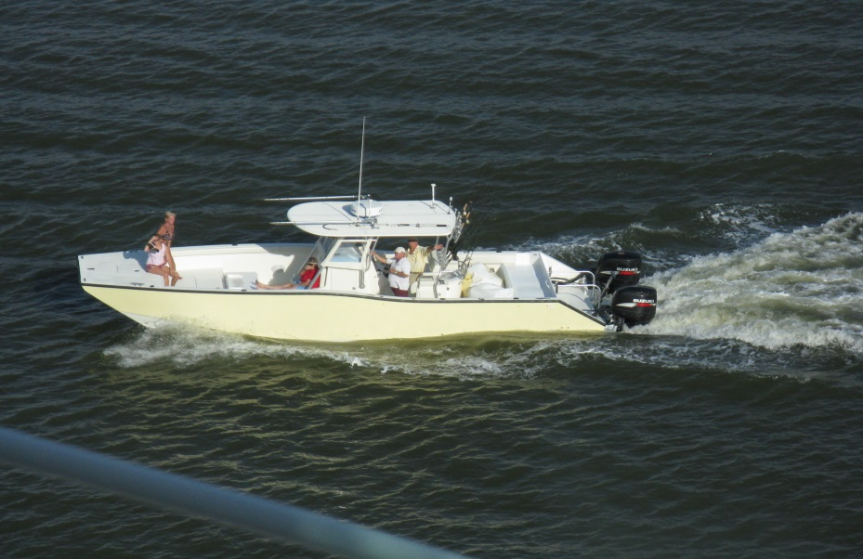
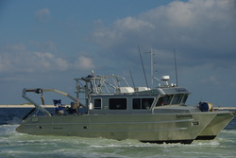
Notes:
Ro/Ros-CHECK, Container ships, CHECK, Commercial research vessels, CHECK, Recreational boats, CHECK. NEXT

Slide 7
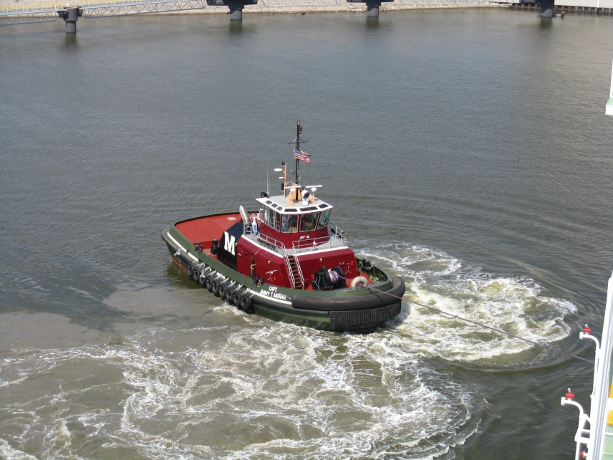
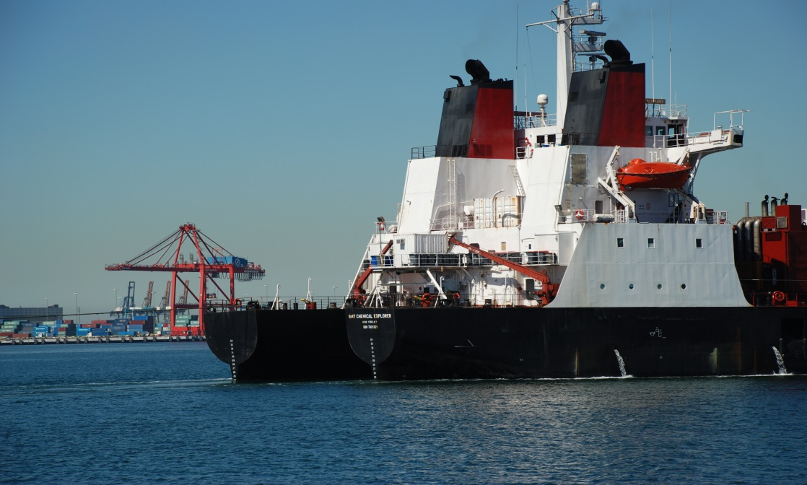
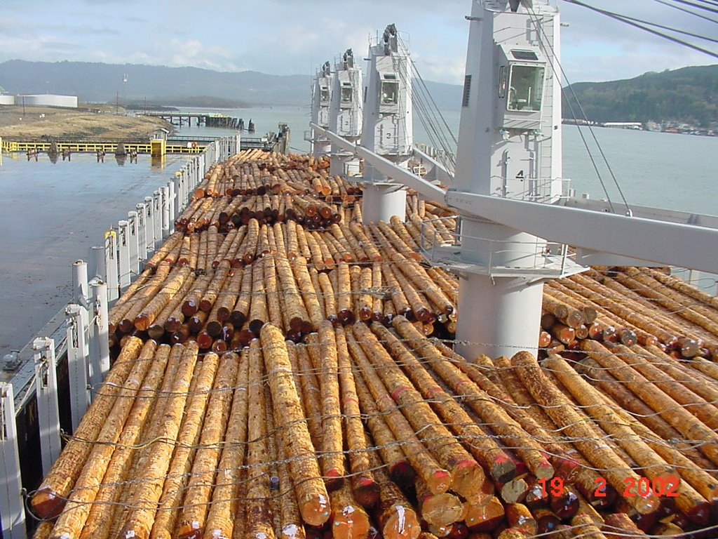
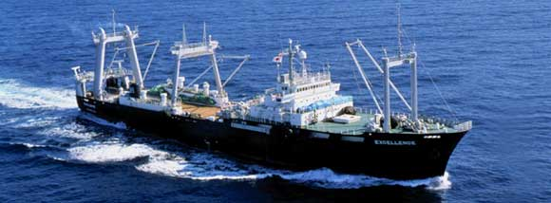
Notes:
Tug boats, CHECK, Integrated tug barges-CHECK, Fish processors-CHECK, Log ships-CHECK. Not to mention break-bulk, chip ships, passenger vessels, supply boats, cable layers, ammunition ships, Ice breakers, car ships…………….on and on

Slide 8
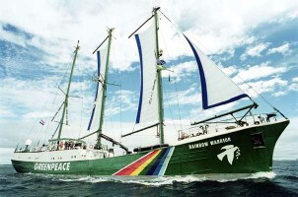
Notes:
basically anything that floats under the rainbow has and will show up.

Slide 9
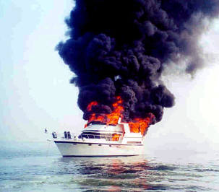
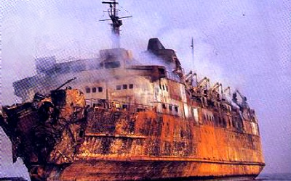
Notes:
Do they burn? From the smallest to the largest. Every single ship type shown that comes to Cook Inlet has burned with loss of life and vessel

Slide 10
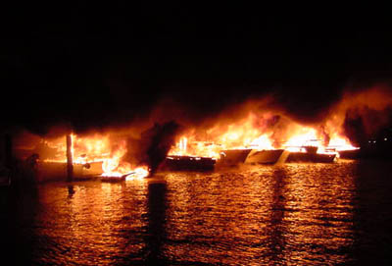
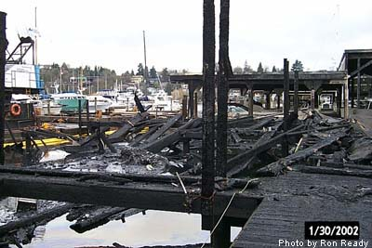
Notes:
Entire Marinas, from boat to boat. It is important to note that statistically we in Alaska have been lucky. Statistically we are long over-due.
We must assume that luck will not last forever, and we must be ready to respond to the fullest

Slide 11
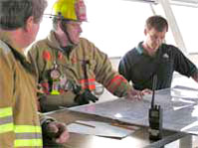
GAP ANALYSIS
Has your department received any training for Marine Firefighting specifically? If so, what type and to what level?
Across the board the answer is minimal, or none. Several have sent a couple of firefighters to the Alaska Marine Firefighting Symposium that has been held every 2 years for some experience. Interest is certainly on the rise.
Notes:
GAP Analysis: I want to start by thanking those who filled out the questioner and for their honesty. Also by saying that in all my years in and dealing with the Fire service I have not met a more dedicated and professional group. Answering these questions is a first step in becoming the best at this speciality. These answers are NO DIFFERENT than most large departments in the lower 48 and nearly all of them just a mere 15 years ago, if that.

Slide 12
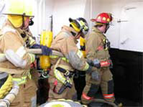
How many full time paid firefighters do you have compared to volunteers?
Of course this varied from all paid to 2 paid full time, depending on department size, however the interesting stat was the fairly large number of volunteers some of the smaller departments carry. The average for the smaller departments was approximately 20-35. EMS training was found to be very high and various levels for almost all departments. Marine FF skills were not as a whole with some exceptions.
We have watched both paid and volunteer departments work together in past symposiums here in Alaska with outstanding results. I am sure the higher numbers of volunteers is partly due to the Alaska spirit and independent thinking!

Slide 13
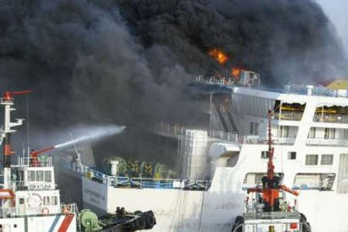
Has your department ever responded to a ship fire? A ship being over 500 ft. for the intent of this survey.
98% have not. Additional information to this question is how many departments have ships call at their port or AOR that are this size. The answer was 6 departments which includes Mutual Aid to the primary department. The number is larger state wide, where three or four departments have responded to a fire once or twice. The state wide number of departments with jurisdiction or an AOR that sees ships of 500 ft. or more is about a dozen. Multiple EMS calls have been conducted on ships over the years at the dock.

Slide 14
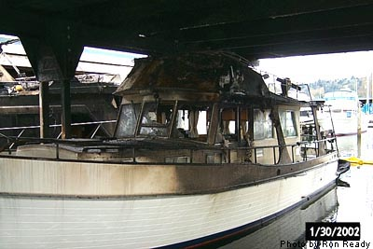
Has your department responded to a commercial boat fire for vessels between 100-500 ft.?
A few in Cook Inlet have reported to have responded to a Marine Fire on this size vessel, however EMS calls have occurred at a much higher frequency.
Has your department responded to a small commercial boat (<100 ft.) fire or recreational boat fire?
Yes. All departments responding to the survey that have a marine or boat storage yard have responded to small boat fires and EMS calls.
Example of EMS calls in Cook Inlet response; this one is from Homer.
many times, including cruise ships, the State Ferries and private vessels. Each is handled in cooperation with the Harbor Officers, port authorities and vessel operators. Some have had to use a dock-side crane to lift the patient on a Stokes to the dock for access. Most use a ships accomodation ladder if tide permits.

Slide 15
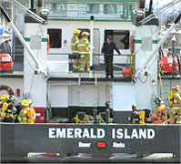
On a scale of 1-10, with 10 being very prepared, how prepared do you feel your department is to respond to a ship fire? Greater than 100’ LOA
A. The average score was 3.5. Higher ratings were 5 and lower were 1. There is a good and solid reason for these ratings and it is the correct and honest ranking. The outcome, while not surprising is something the MFF workgroup and other avenues with private sector (Salvage companies & training) can overcome.

Slide 16
While the number who responded was higher for vessels less than 100’ length, the responses were very low to a high of 8. It must be noted that the smaller departments have in some cases many small boats and a harbor. Major shipping berths in Cook Inlet for the most part do not, thus the smaller departments were reported to be much more comfortable in fighting these type fires. This would include fuelling docks, fires in slips and fishing vessel fires in port.
Would you feel comfortable sending your firefighters on board a ship to respond to a deck or engine room fire?
A. In general the answer was not comfortable at all at their current MFF training level. Some said yes with “the right company level officers’ to a level equal to their training.
Is your department as a whole familiar with NFPA 1405 Guidelines or NFPA 1005 Standards?
A. No, not as a whole or inter department training program. Some departments have sent some of their firefighters to speciality schools such as Texas A&M Marine Firefighting. Some have also sent a couple to the Alaska Marine FF symposium as well. State certification should greatly assist in this endeavour.

Slide 17
Conclusion:
Cook Inlet Fire Departments are not ready as a whole to deal with a ship fire. Some are prepared to deal with smaller boat fires and do so on a regular basis. All are capable of EMS response to vessels for extrication to local hospitals and advance treatment. As a point of interest most of the smaller departments and all in general are very competent in EMS and have excellent EMS qualifications, far exceeding the size of their department and what one would expect nationally. The good news is they are not that far behind many, iof not most of the lower 48 coastal departments, including some mega departments who are now just getting into some good training. This is a goal that is not out of reach to achieve. By virtue of the Symposium being held in Valdez for many years we have seen a department that could not and would not respond to a ship fire, to one that the vast majority of members are better trained than some nameless departments south who are bigger-to the tune of about 6 million people bigger. It can be done!

Slide 18
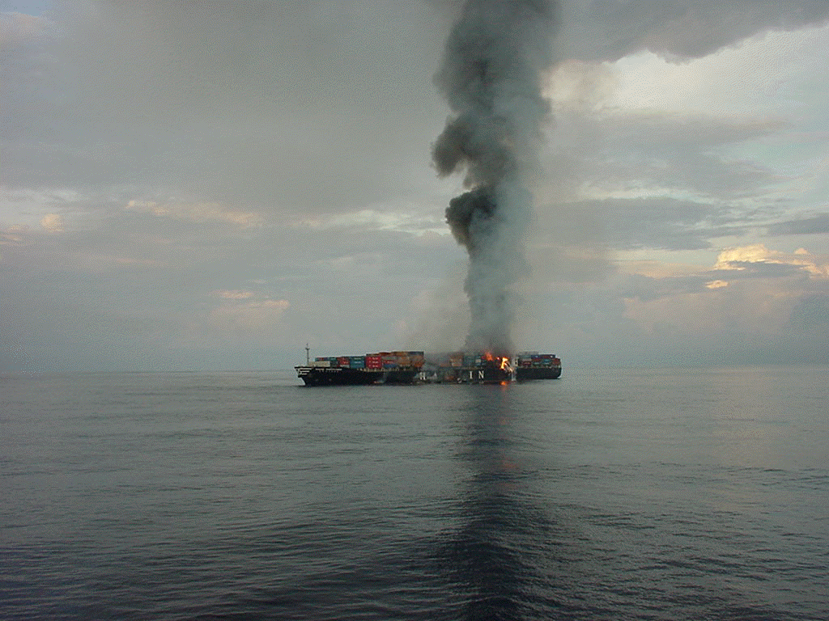
M/V Hanjin Pennsylvania

Slide 19
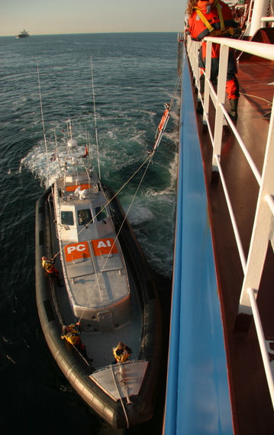
EMS responses in Cook Inlet have included AMS Ferry, Passenger Vessels, fishing vessels and other types of vessels. Some coordinate with the local port authority to coordinate medivac and other smaller departments deal with response solely on their own.

Slide 20
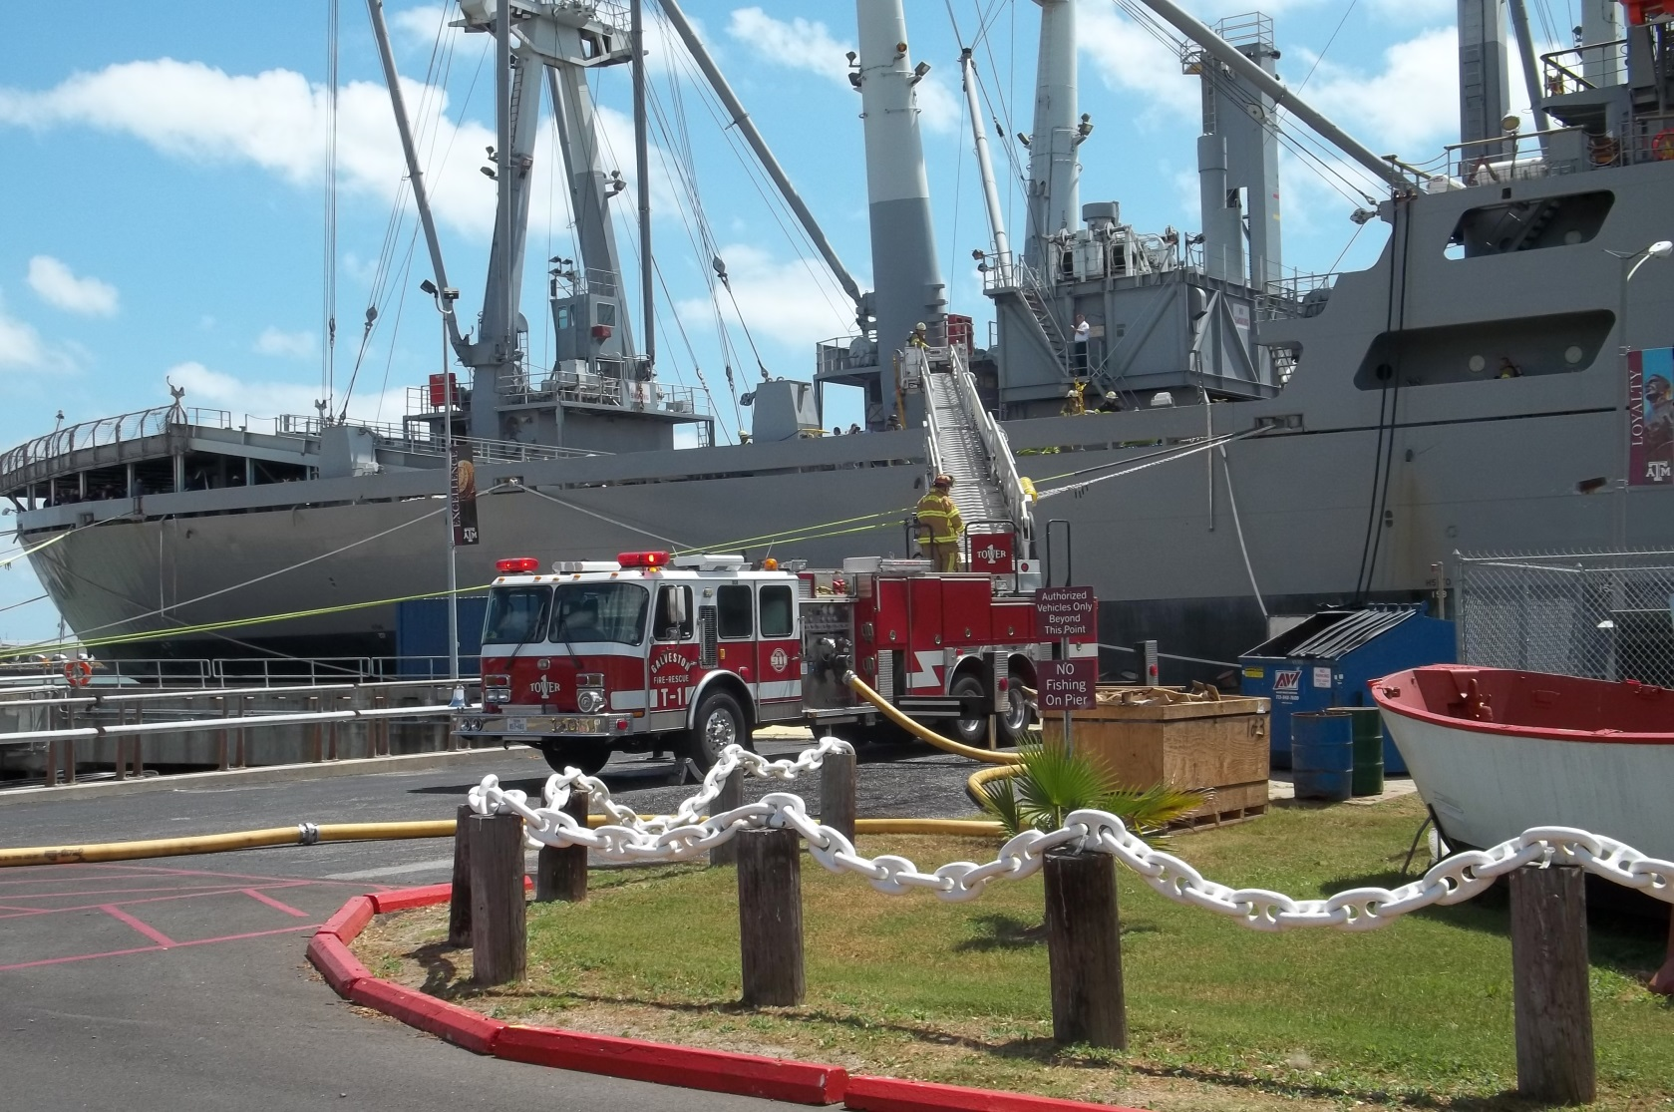
All departments in Cook Inlet are interested in more Marine specific fire training but all are also constrained by budgets as well.
All departments would like to see more MFF drills, either hands on or planning exercise drills.

Slide 21
Recommendations:
Alaska is almost totally dependent on shipping to receive its daily necessities and totally dependent on shipping for exporting its natural resources. Closing a port for a fire is almost not an option for a long period of time. Industry expects, naively, that a full response is coming when 911 is called as it is in some of the larger ports they frequent. Captains of oceangoing ships do not have the crew size to fight a sustained fire of any size for a prolonged period and you will find most non US flag vessels even less able.
To correct the above GAPs, the following are highly recommended action items that the MFF workgroup accomplish. These are not short term solutions but will require a long term planned attack of the problem with follow-up.

Slide 22
Departments that have ships calling in their port or anchor in their port should investigate all available Grant monies for training.
Mutual Aid departments to the above should conduct drills with their MOU departments specifically on MFF.
Departments should attempt to include monies in their budget for MFF drills.
Departments are encourged to coordinate directly with Salvage Response Organizations regarding consent agreements, training and coordinating a public and private response to the benefit of industry users.

Slide 23
Coordination must be made with the USCG, State, MFF Workgroup, Local and Private entities to conduct at least yearly, a Marine Firefighting Table-Top exercise. These are conducted throughout the lower 48 in ports facilitating ships and are usually sponsored by the USCG. They consist of:
A review of Policies and Procedures for responding to a vessel disaster in and around the Port complex.
Explore and revise as needed the various roles and responsibilities of responders, local agencies and Industry.
The integration of municipal and commercial response resources.
USCG and other management of numerous operational priorities and resources.
The transition from emergency response to recovery.
Assess area strengths and insure they are in the ACP. (In progress with the MFF workgroup and USCG Planning at this time. Present to Industry the changes of various plans such as the ACP to Industry for buy-in and comment.
Assess weaknesses to the system.
Plan to conduct tactical exercise with the public and private FF’s at this table-top meeting.

Slide 24
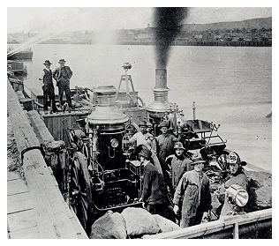
STATE MFF CERTIFICATION
The State of Alaska Fire Standards Counsel has adopted NFPA 1005 for the state standard for MFF certification. The counsel is now working with Proboard and IFSAC to develop the process for certification. There is no current timeline for this process but experience has shown this to be a drawn out process. It may be possible to have this in place before the spring 2017 MFF symposium but there are no guarantees .
Typically this certification requires 40 hours of training and various task to be completed on-board vessels. A suggested format is to develop a task book where firefighters can have the various task signed off by a training officer in their department.

Slide 25
PLANS
On Feb. 10, 2016 the Marine firefighting Workgroup for the Cook Inlet Harbor Safety Committee met in Homer, AK. Our mission for that meet was to identify some specific issues regarding planning, preparedness and response to marine incidents within Cook Inlet. One of those issues had to do with identifying the different response plans and to find synergy within those plans with a goal of coordinating all response plans in some way so that they complement one another rather than stand alone.
After the workgroup meeting and subsequent conference calls with USCG our focus moving forward will be to engage all responders within the sub area plan.In order to accomplish this we decided to hold a workshop on the subject and bring responders into the process of revising the MFF annex in the sub area plan.
The workshop will be co-facilitated with the USCG, who has already accepted this role with initial plans for this meeting in Nov 2016.. We have socialized this concept with many of the local fire departments and have received their and the USCG’s support.
There are several potential solutions to making this a fit for purpose solution for responders which will be explored in the workgroup meeting with the USCG.

Slide 26
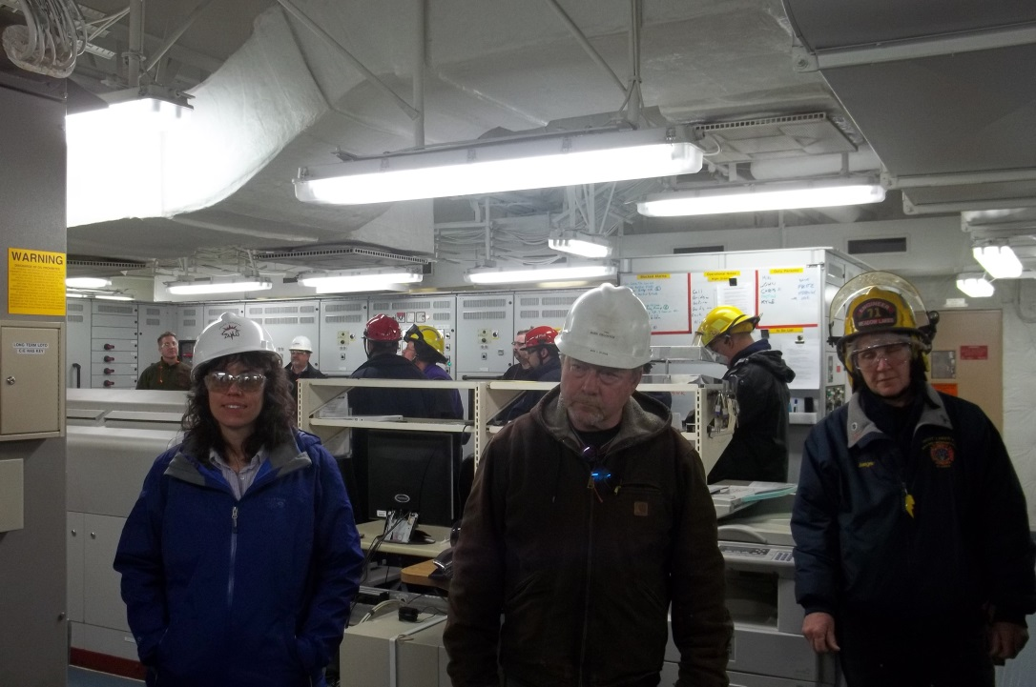
MARINE FIREFIGHTING SYMPOSIUM
Currently in the planning stages, it is anticipated to have the 2017 Marine Firefighting Symposium in May, 2017 at Homer Alaska.
History of the symposium dates back to the 1990’s where the first one was held in Valdez Alaska. It was sponsored by the PWSRCAC and fire departments from one end of the state to the other who had marine responsibilities were invited cost free. The symposium in the intervening 20 plus years has trained literally 100’s of Fire Department personnel to NFPA 1405 guidelines and when able to NFPA 1005.
Inlet and elsewhere in the State.

Slide 27
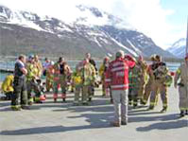
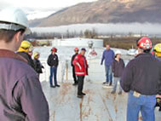
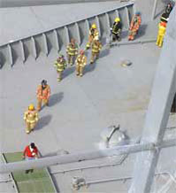
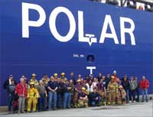
These symposiums are held every 2 years and consist of a walkthrough of ships. Marine Firefighting, Tank Farm firefighting, working with ship crews, Vessel Fire Plans table-top discussions, live smoke drills and smaller boat fires, initial first in engine response, ship stability and many other areas crammed into 3 full days.

Slide 28
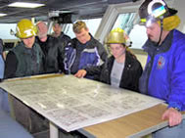
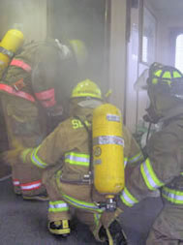
Typically it started and will continue next year with a 2 track program. Operations and Command tracks have proven very successful and our thought is to continue this practice. Ship traffic has drastically been reduced in Valdez but the symposiums will go on and adapt. By having the forth coming symposium in Homer it will allow more participation from more departments as it is logistically easier to get to and from. It is also a perfect fit for the HSC’s MFF workgroup to address some of the areas needing improvement.

Slide 29
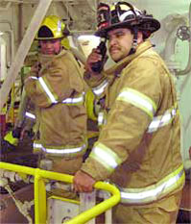
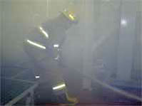
We have had as many as 300 people attend with the average size actually about 40 firefighters. Thousands of feet of hose have been laid, engine room’s blacked out and SAR on various boats accomplished. Due credit should be given to the RCAC for seeing the importance of this symposium. We would like this coming symposium to be the most productive of all of the last 20 years and special attention to closing gaps and continuous improvement for the MFF workgroups mission statement for all the departments in Cook

