Slide 1
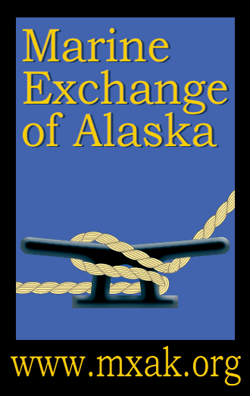
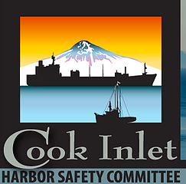
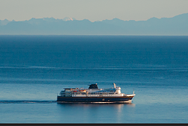
Marine Exchange of Alaska
Technological Tools for Enhancing Maritime Safety
Briefing by Brett Farrell
Assistant Director, Marine Exchange of Alaska
Providing information, communications and services to aid safe, secure, efficient and environmentally sound maritime operations

Slide 2
Application of AIS Technology in Cook Inlet
AIS – Use of Track Histories for Risk Assessments
Information to Mariners -WX and Current Stations
Port Planning
AIS Network and Vessel Tracking

Slide 3
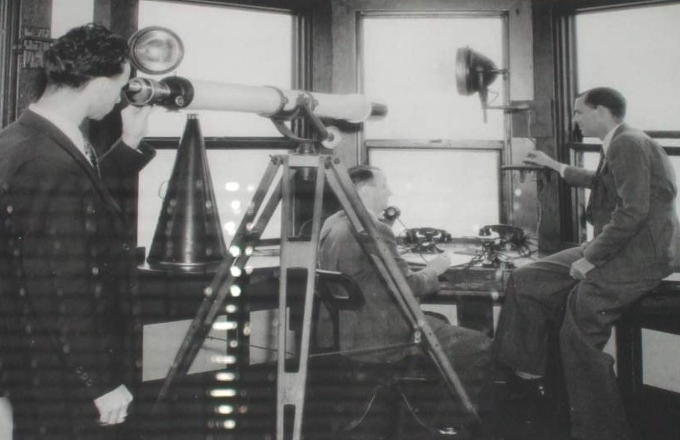
Marine Exchange Ship Spotting
Telescopes

Slide 4
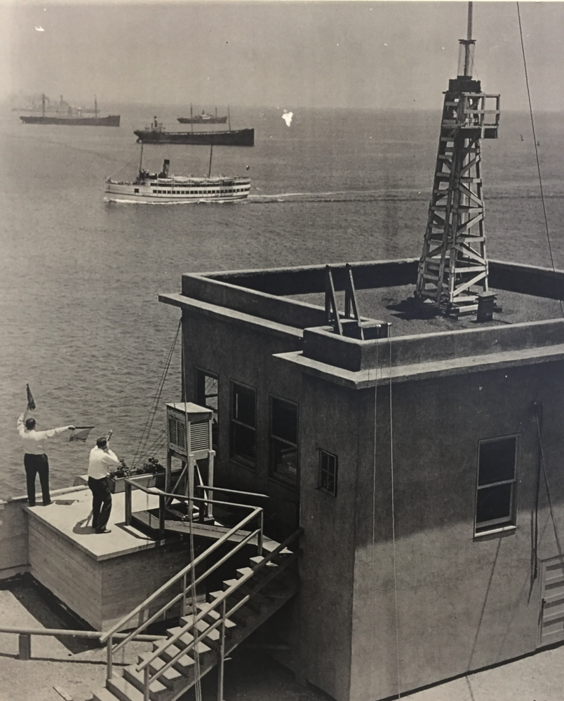
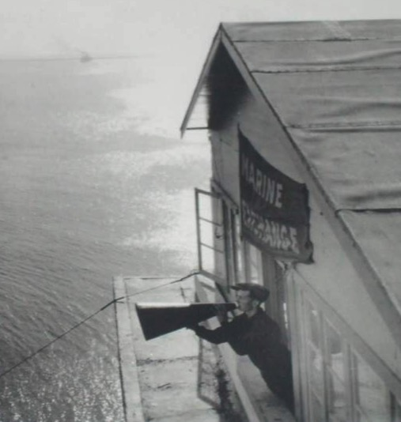
Marine Exchange
Communications
Semaphore and
Megaphone

Slide 5
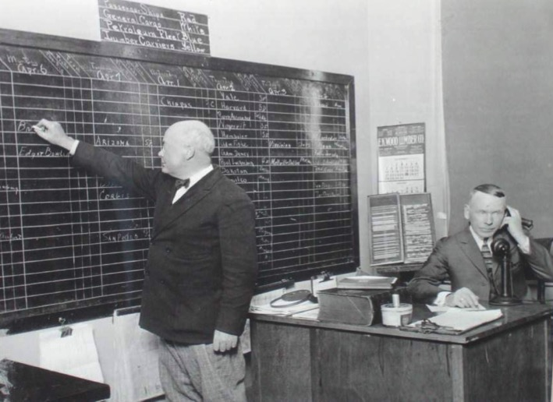
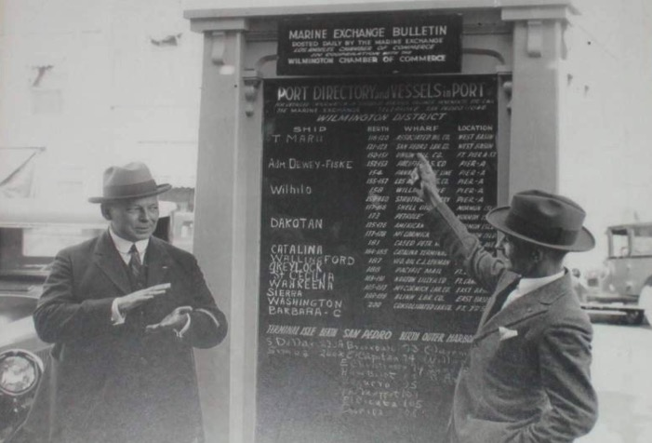
Marine Exchange
Dissemination of Maritime Information
Phones
and
Chalkboards

Slide 6
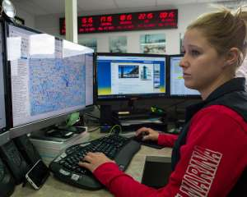
Marine Exchange of Alaska Today
AIS
Satellites
Computers
Internet

Slide 7
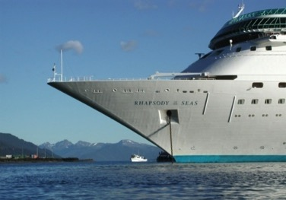
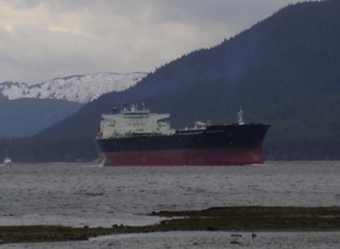
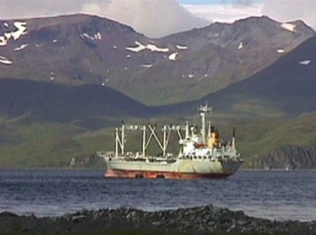
Why Track Vessels?
Safety Net
Risk Assessments
Environmental Protection
Aid Compliance
Emergency Response
Improve Efficiency
Maritime Security
Safe, Secure, Efficient and Environmentally Sound Maritime Operations

Slide 8
Vessel Tracking Technology
AIS (Automatic Identification System)
  Terrestrial Based Stations (real time – near shore – tactical )
  Satellite AIS receivers (delayed – offshore - strategic )
Satellite Transponders
  Regular intervals – normally hours apart

Slide 9
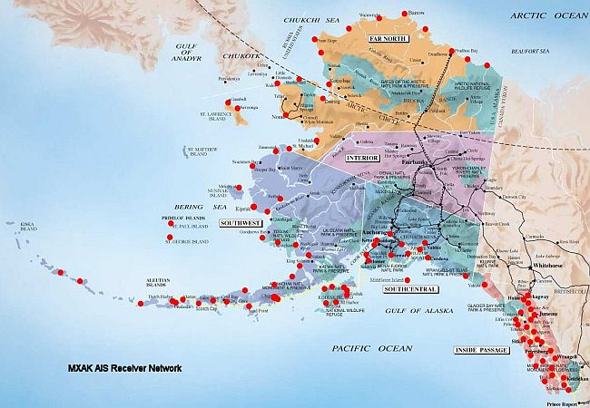
MXAK Alaska Terrestrial AIS Network

Slide 10
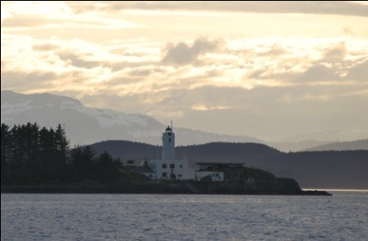
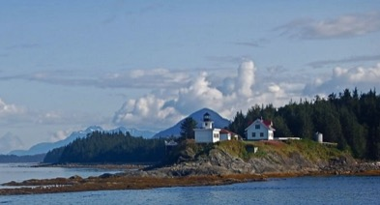
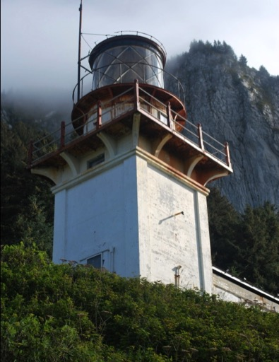
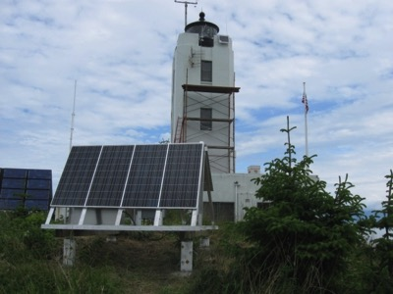
AIS Stations in Alaska
Alaska Maritime Community Support of AIS Network
Lighthouse Associations
Pilot Stations
Harbor Offices
Fish Hatcheries
Tug Offices
Shipping Companies
Fish Processing Plants
Tribal Offices
Oil Facilities
Science Centers
Oil Spill Response Organizations

Slide 11
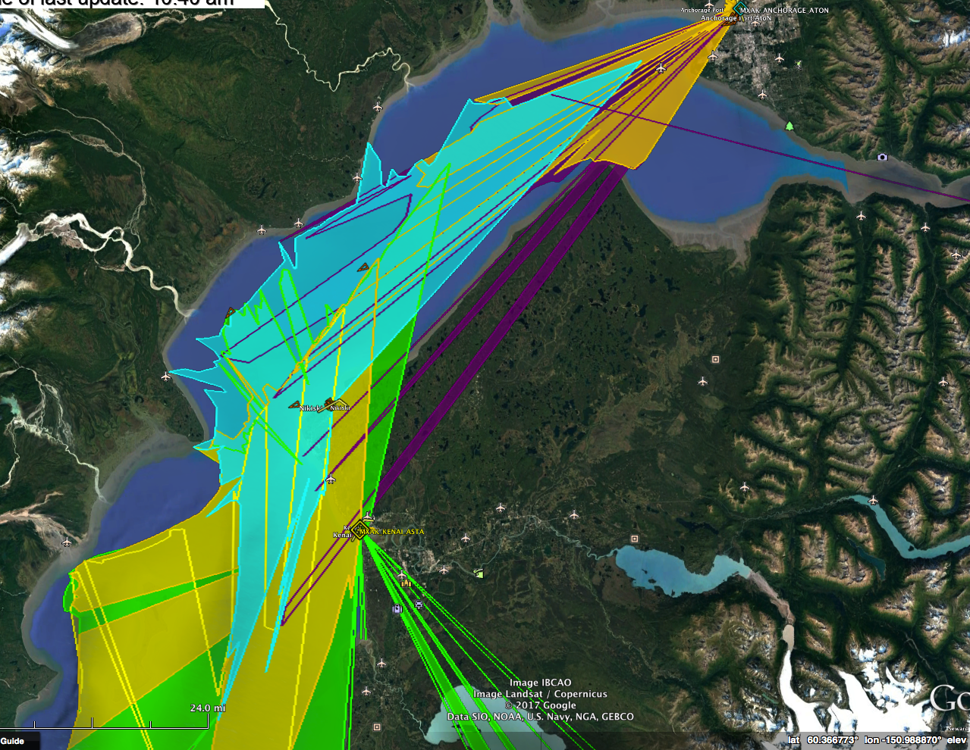
AIS Coverage

Slide 12
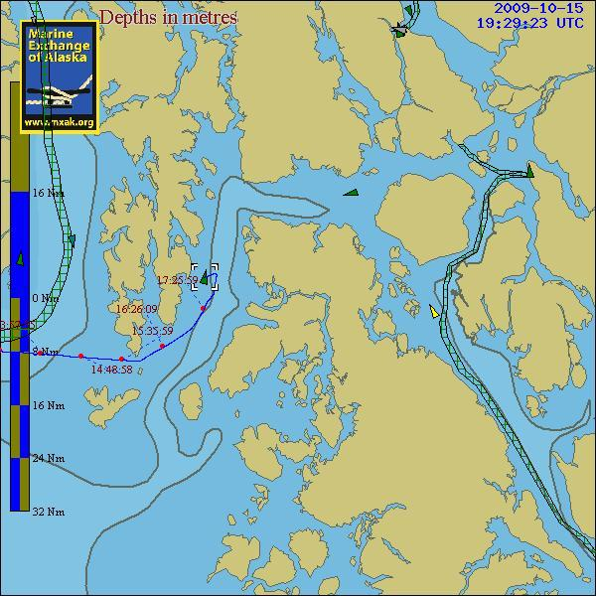
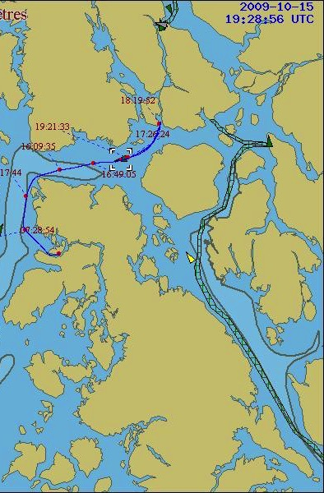
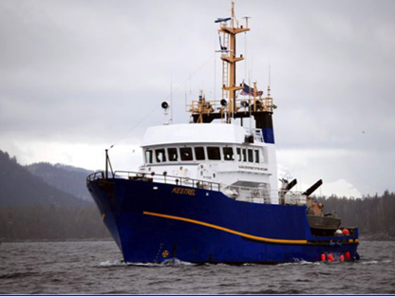
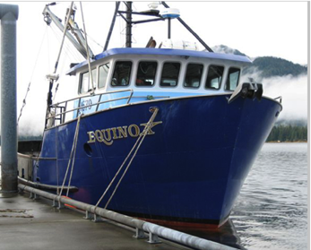
Domain Awareness & SAR
Kestrel
Equinox

Slide 13
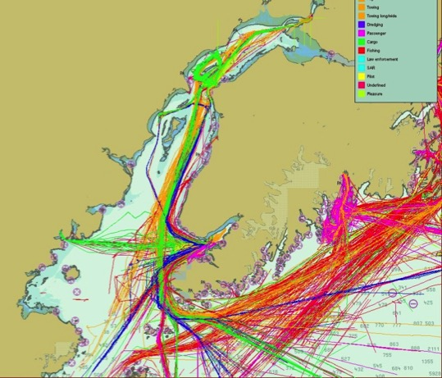
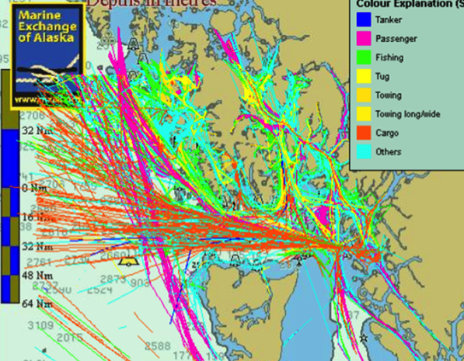
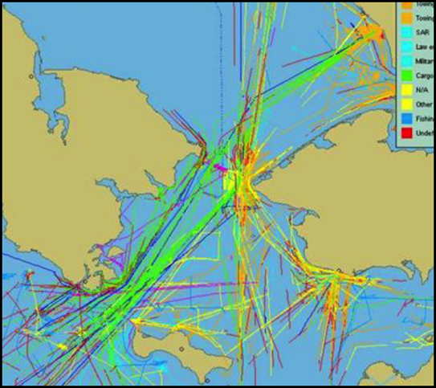
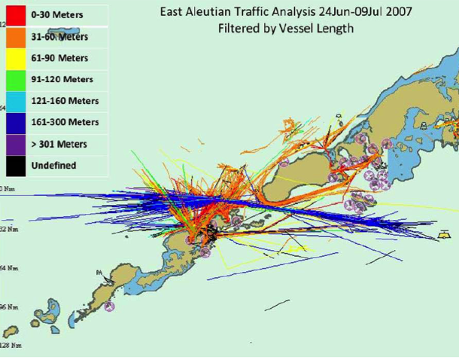
Cook Inlet
Southeast
Maritime Traffic Analysis
Arctic
Aleutians

Slide 14
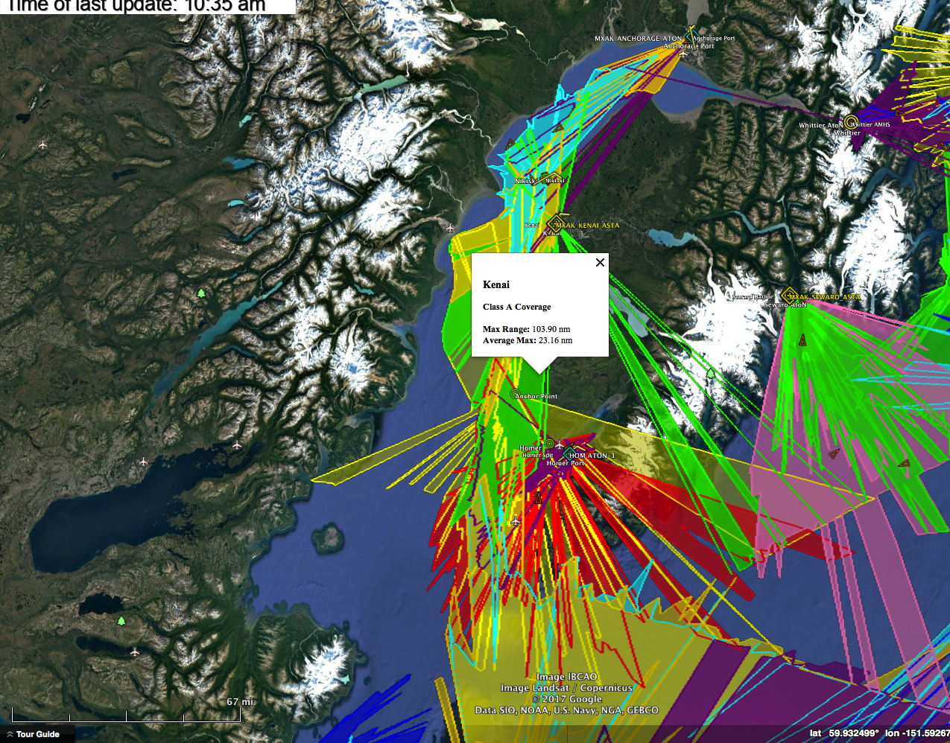

Slide 15
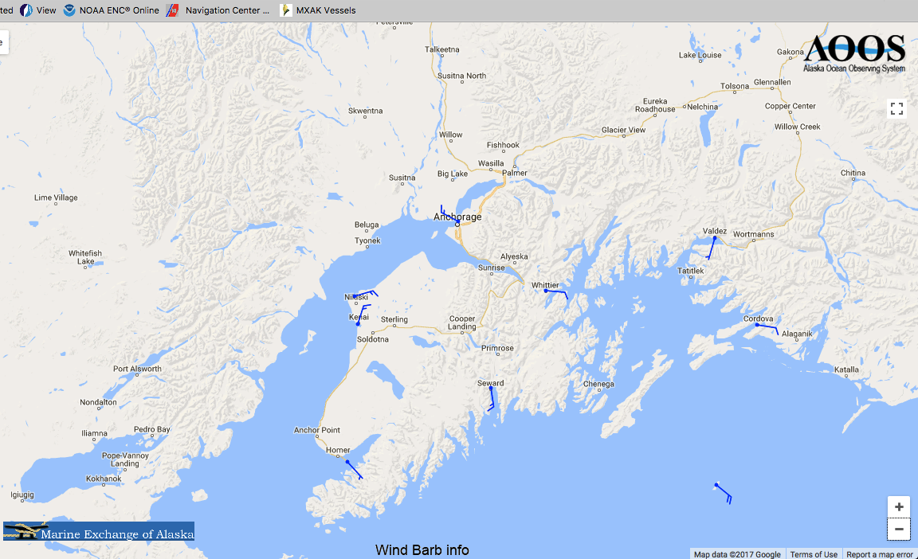
Weather Stations Cook Inlet

Slide 16
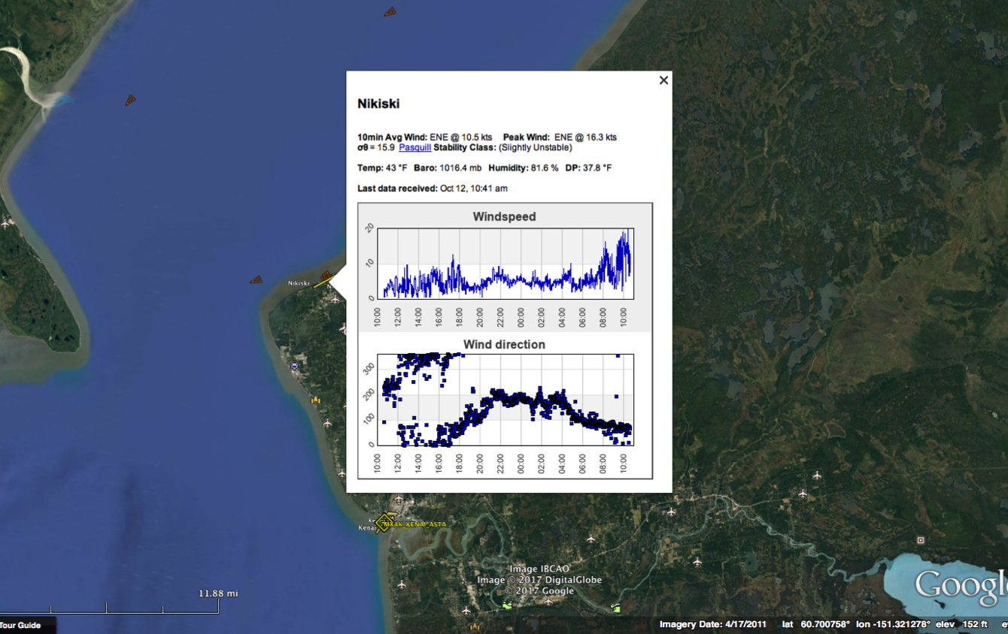
Weather Station at Kenai

Slide 17
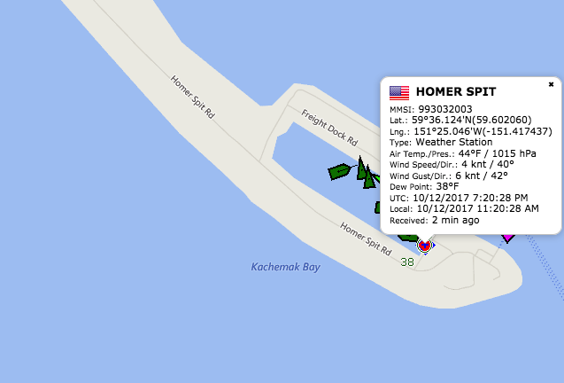

Slide 18

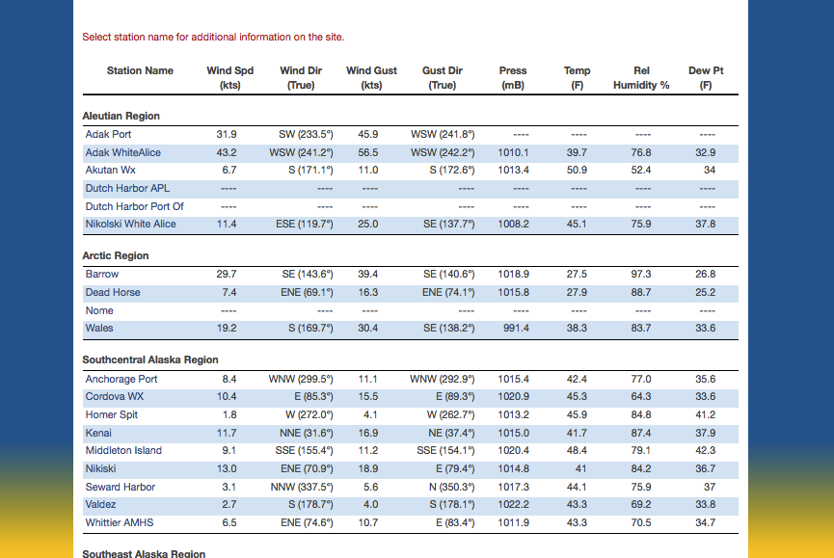
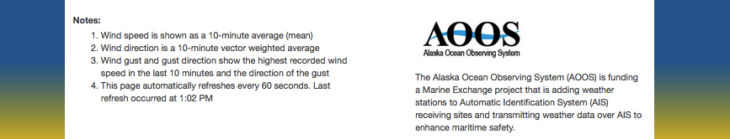

Slide 19
Virtual Aids to Navigation

Slide 20
Virtual Aid to Navigation

Slide 21
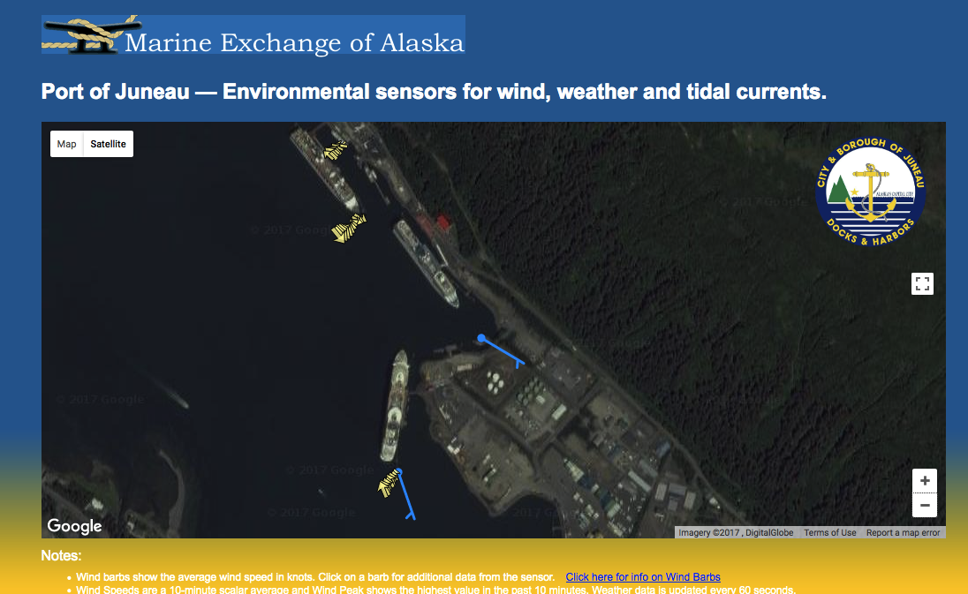
Port of Juneau Wind and Current Sensors

Slide 22
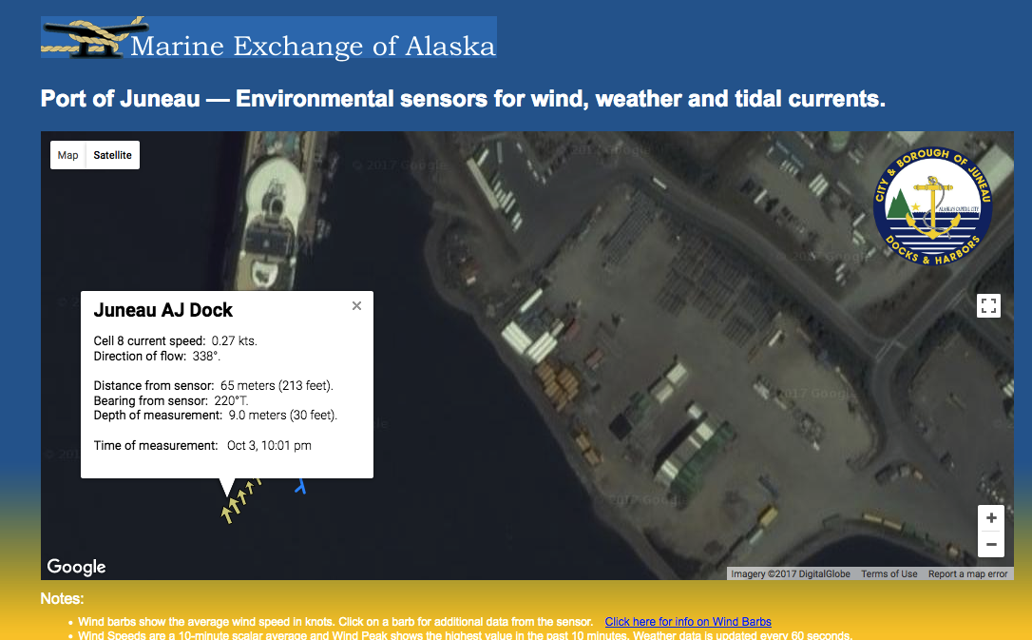
Port of Juneau Wind and Current Sensors

Slide 23
Enhancing Maritime Safety
Offshore Waters
Aiding compliance with risk mitigating routing measures
Identifying disabled vessels in need of assistance
Making timely notifications of marine casualties
Locating emergency response resources
Inside Waters
Virtual aids to navigation
Dissemination of weather, current and ice conditions
Dissemination of Notice to Mariners via AIS
Timely notification of marine casualties and locating response resources

Slide 24
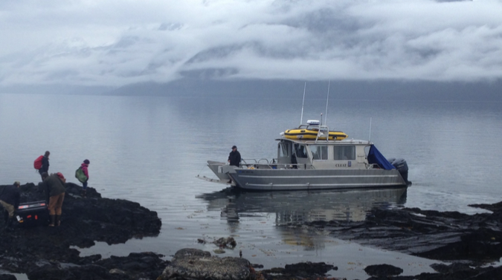
Marine Exchange of Alaska
Providing information, communications and services to aid safe, secure, efficient and environmentally sound maritime operations.

